Slide 1
Assignment 3 Graphical Representation of Systems
Nusair Islam

Slide 2
1. Convert SFG into Block Diagram
CONSTANTS:
G1 = 3/(s+7)
G2 = 3/(s+7)
H1 = 9
H2 = 8
H3 = 10
H4 = 1/(6s)
H5 = 7/s
H1
H2
Input
G1
G2
Output
H4
G1
H5

Slide 3

2. Transfer Function
$$\frac{18s}{418s^{3}+5852s^{2}+20403s^{}+203}$$

Slide 4

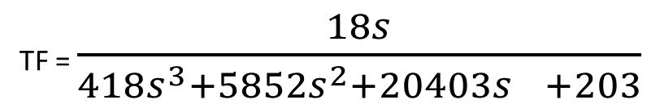
3. Mason’s Gain Formula
TF = $\frac{18s}{418s^{3}+5852s^{2}+20403s^{}+203}$

Slide 5
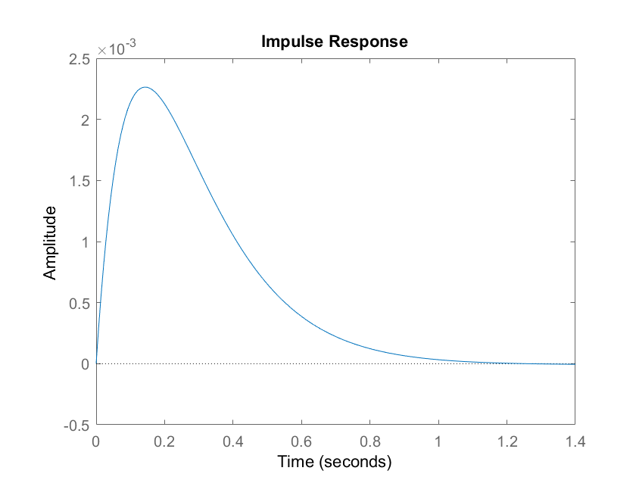
4. MatLab Impulse Response

Slide 6
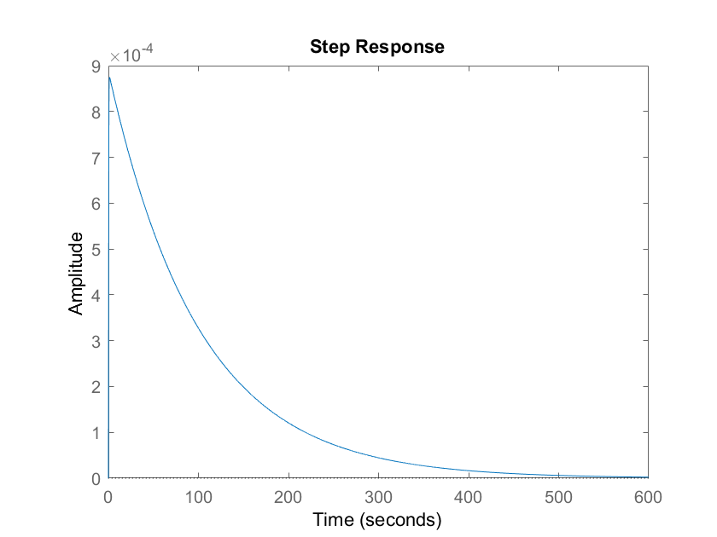
4. MatLab Step Response

Slide 7
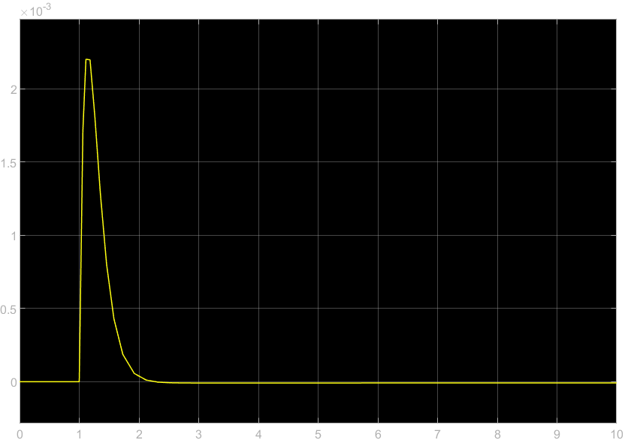
5. Simulink Impulse Response

Slide 8
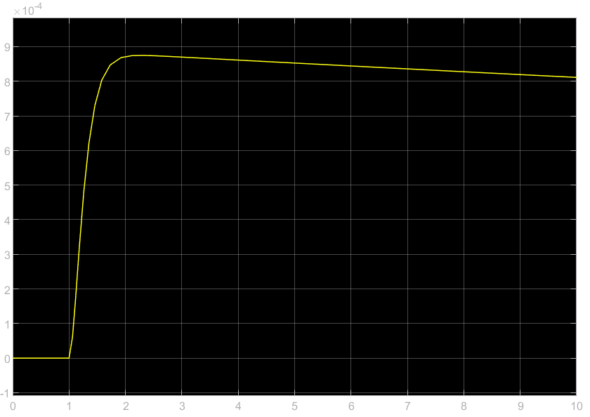
5. Simulink Step Response

